Slide 1

AKS Office Hours
Kendall Roden
Cloud Native Technical Specialist
Kendal Roden
Cloud Native Technical Specialist
Dave Strebel
Cloud Native Technical Specialist

Slide 2
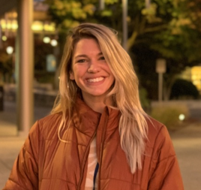
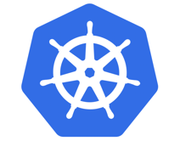


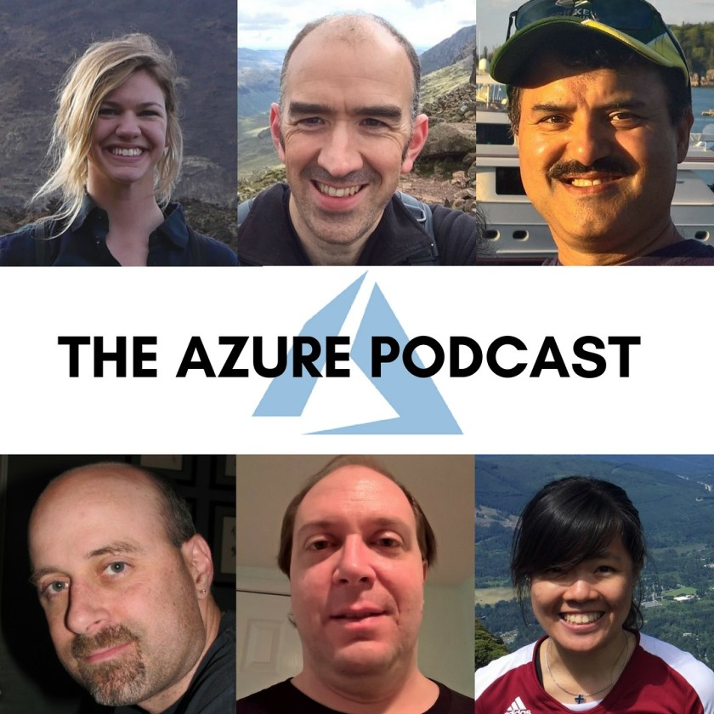

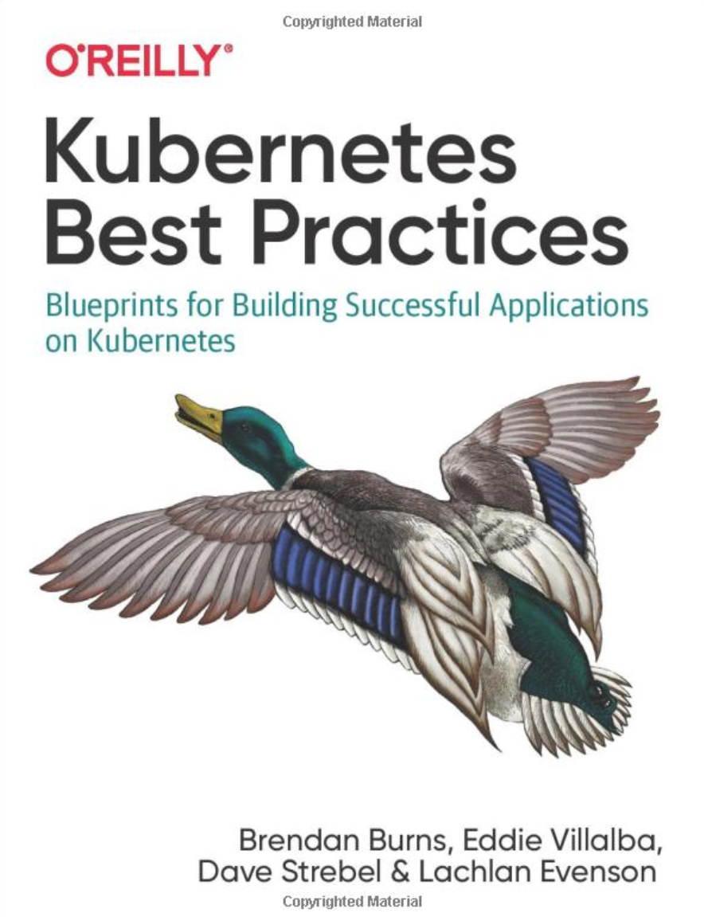
Who are we?
@kendallroden​
@dave_strebel​

Slide 3
Why AKS Office Hours?
Provide AKS customers with updates pertaining to AKS and the Cloud Native Ecosystem
Host a short talk and/or demo on Cloud Native technologies related to Kubernetes and AKS
Collect feedback from customers on issues, blockers, use cases, and questions related to AKS

Slide 4
What to expect
Call agenda
10 minutes: Welcome, followed by AKS and ecosystem updates
40 minutes: CI/CD with Kubernetes
10 minutes: “Ask us anything” and customer feedback discussion
Keep in mind
Office hours are hosted primarily by the GBB team, with the support of the PG
Recordings and content will be available post-call on GitHub, barring any technical difficulties
Contact us with thoughts, ideas or questions (aksofficehours@microsoft.com)

Slide 5
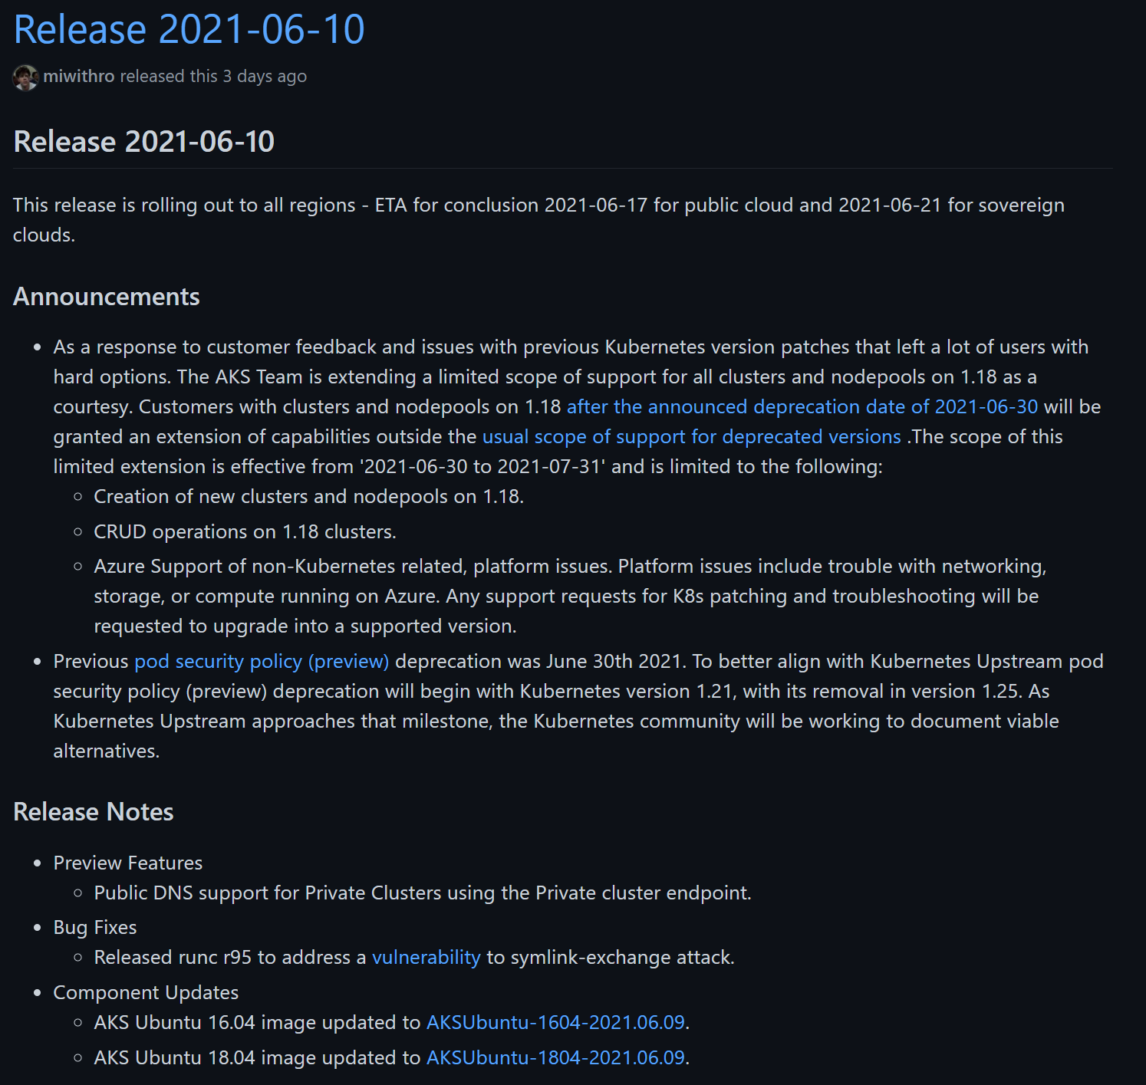
AKS Release Notes
1.18 scope of this limited extension is to 2021-07-31' and is limited to the following:
Creation of new clusters and nodepools on 1.18.
CRUD operations on 1.18 clusters.
Any support requests for K8s patching and troubleshooting will be requested to upgrade into a supported version.
PSP deprecation will begin with Kubernetes 1.21
Preview of Public DNS support for Private Clusters
Notes:
Key points:
1.20 out in preview! Deprecation: https://docs.microsoft.com/en-us/azure/aks/supported-kubernetes-versions#aks-kubernetes-release-calendar
1.20 overview: https://kubernetes.io/blog/2020/12/08/kubernetes-1-20-release-announcement/
Starting in version 1.20, timeouts on exec probes are honored, and default to 1 second if unspecified. If you have Pods using exec probes, ensure that they can easily complete in 1 second or explicitly set an appropriate timeout. For more information, see ConfigureProbes.

Slide 6
Ignite AKS Updates
Generally Available:
Conditional Access
Public IP per node
Arc for K8s
App Gateway Ingress Controller add-on
Just in Time Access Support
Confidential computing nodes
Custom Weblogic containers
Persistent Volume Monitoring
Public Preview:
Calico on Windows Server
Planned Maintenance window
Dynamic IP Allocation
Kubenet Support for Pod Identity
…and more!
Notes:
AKS Ignite Updates:
GA for Conditional Access (MFA): https://azure.microsoft.com/en-us/updates/general-availability-conditional-access-feature-integration-with-aks/
GA Public IP per node - direct access to node not through a LB (for low latency scenarios): https://docs.microsoft.com/en-us/azure/aks/use-multiple-node-pools#assign-a-public-ip-per-node-for-your-node-pools-preview
GA Arc for K8s: also includes Azure Arc enabled ML https://azure.microsoft.com/en-us/blog/innovate-across-hybrid-and-multicloud-with-new-azure-arc-capabilities/
GA AGIC add on - create or attach: https://azure.microsoft.com/en-ca/updates/general-availability-app-gateway-ingress-controller-addon-for-aks/
GA Just in Time Access rules for tasks with elevated permissions: https://azure.microsoft.com/en-us/updates/general-availability-justintime-access-support-in-aks/
GA confidential computing nodes on AKS - https://azure.microsoft.com/en-us/updates/confidential-computing-nodes-aks-ga/
GA Weblogic on AKS - instructions, samples and scripts to build custom images based on Weblogic: https://azure.microsoft.com/en-us/updates/general-availability-deploy-weblogic-on-azure-kubernetes-service-aks-using-custom-docker-images/
GA Persistent Volume Monitoring for AKS - visualization, querying ability on metrics/logs and reports tab: https://azure.microsoft.com/en-us/updates/general-availability-of-persistent-volume-monitoring-reports-tab-in-container-insights/
Pub Prev Calico on Windows Server - 1.20 k8s version and Azure CNI only: https://azure.microsoft.com/en-us/updates/public-preview-calico-windows-support-in-aks/
Pub Prev Planned Maintenance window - for controlling releases/proactive maintenance events: https://docs.microsoft.com/en-us/azure/aks/planned-maintenance
Pub Prev Dynamic IP Allocation - different subnet for pods and nodes in AKS, dynamically allocate ips to pods instead of preallocation to node (!!!) - https://azure.microsoft.com/en-us/updates/public-preview-dynamic-ip-allocation-enhanced-subnet-support-in-aks/
PP Kubenet support for Pod identity: https://docs.microsoft.com/en-us/azure/aks/use-azure-ad-pod-identity

Slide 7

Ecosystem Updates

Slide 8
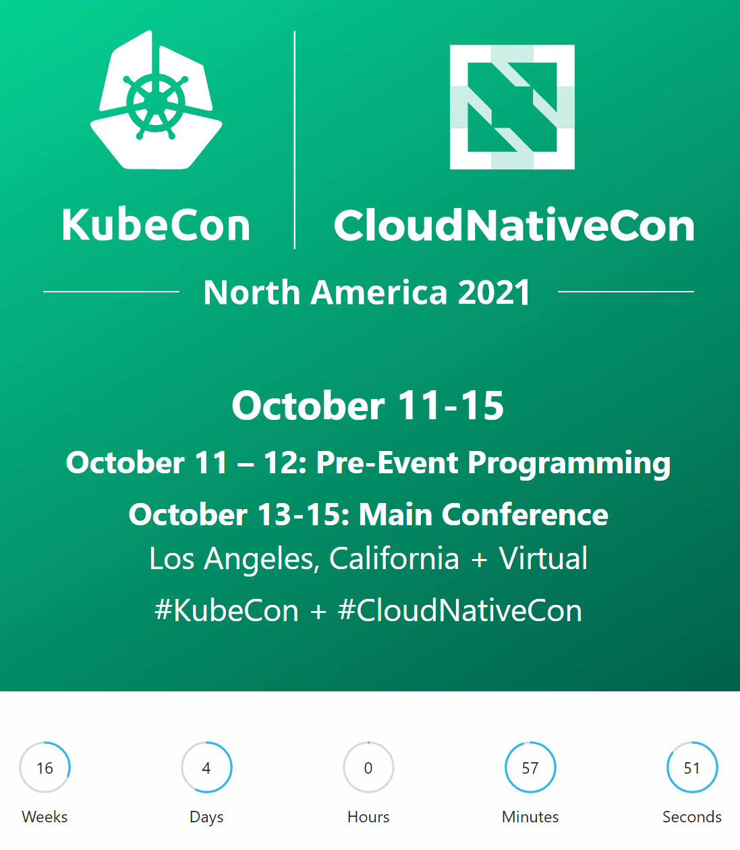

Slide 9

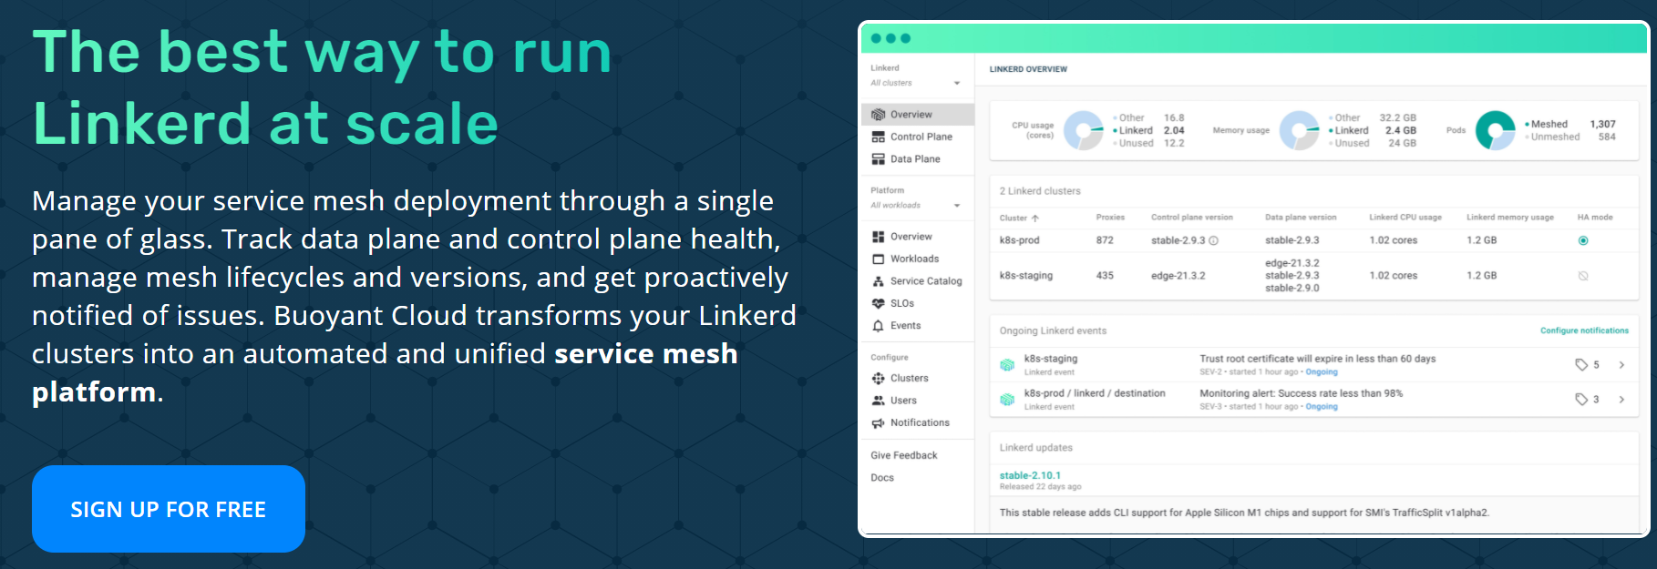
Join us on Thursday, July 1st @ 9am PT / 11am CT / 6pm CET!

Slide 10
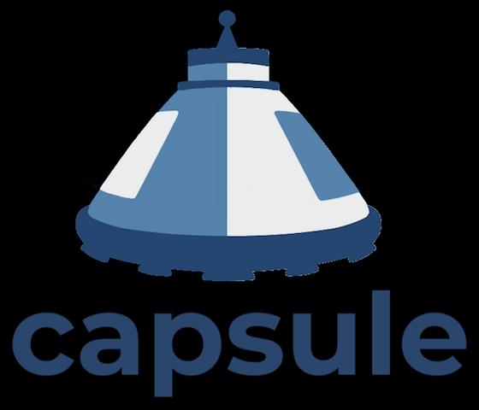
Capsule – 0.5.0 Released
Capsule helps to implement a multi-tenancy and policy-based environment in your Kubernetes cluster. It is not intended to be yet another PaaS, instead, it has been designed as a micro-services-based ecosystem with the minimalist approach, leveraging only on upstream Kubernetes.

Slide 11
CI/CD with Kubernetes

